Slide 1

Year 6 SATs Presentation for Parents
Wednesday 24th September 2024
Thank you for attending this evening ☺

Slide 2

What will we cover in this meeting?
What are the SATs?
When are the SATs?
What do the questions look like?
Special arrangements
Writing
How can you help your child?
Mock week
The week itself
Things to remember
Revision guides
Reminder about online safety

Slide 3

What are the SATs tests?

Slide 4

The SATs tests
The end of KS2 assessments are sometimes informally referred to as ‘SATs’.
SATs stands for Statutory Assessment Tests and they are held at the end of Key Stage Two.
It is a statutory requirement for year 6 pupils in state primary schools across the country to do the SATs.
Tests are created by the Standards and Testing Agency.

Slide 5
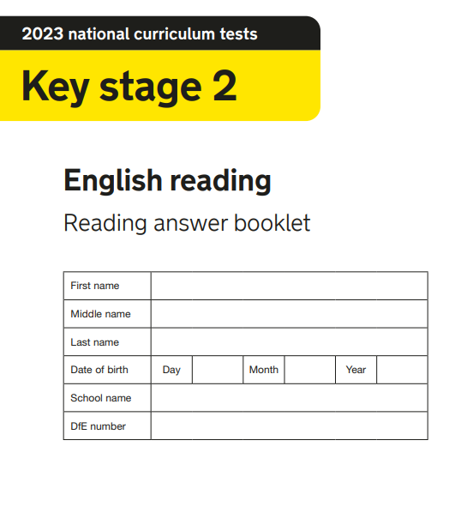
The SATs tests
The SATs papers consist of:
-English Reading
-English Paper 1: Grammar, Punctuation & Spelling
-English Paper 2: Spelling
-Mathematics: Paper 1 Arithmetic, Paper 2 Reasoning, Paper 3 Reasoning
Writing is assessed using evidence collected throughout year 6. There is no year 6 SATs writing test.

Slide 6
WHEN ARE THE SATS?

Slide 7
The SATs tests
Monday 11th May 2026 | Tuesday 12th May 2026 | Wednesday 13th May 2026 | Thursday 14t^{h} May 2026
English Paper 1: Grammar, Punctuation & Spelling (45 minutes) English Paper 2: Spelling | English Reading (1 hour) | Mathematics Paper 1: Arithmetic (30 minutes) Mathematics Paper 2: Reasoning (40 minutes) | Mathematics Paper 3: Reasoning (40 minutes)

Slide 8
How are the tests graded?

Slide 9
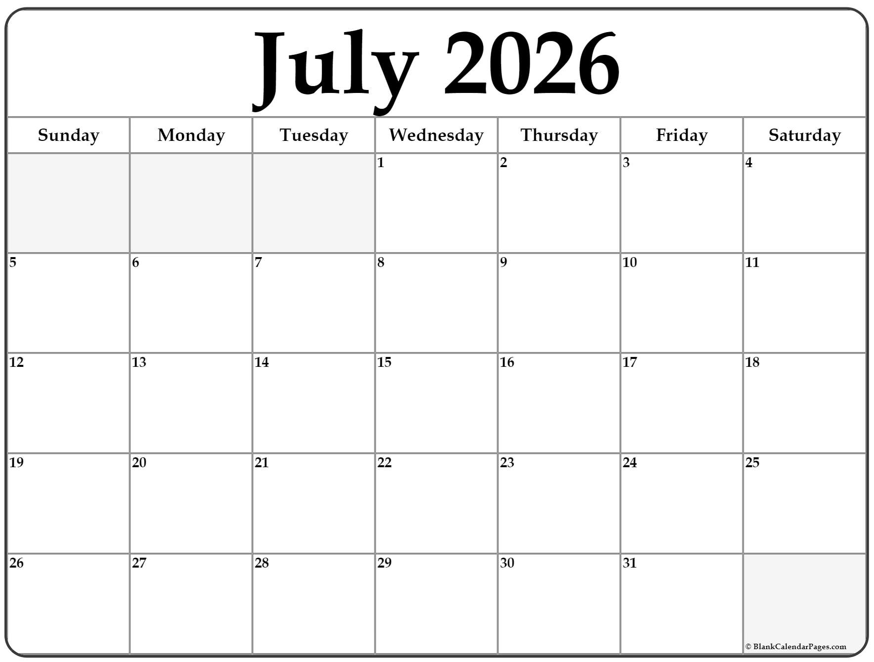
Grading of the Tests
SATs tests are marked externally; the school receives the results inJuly.
The marked tests will provide the following information:
-A raw score
-A scaled score
-An indication of whether the national standard has been met.

Slide 10
Grading of the Tests
A child awarded a scaled score between 100-109 is judged to have the ‘national standard’ (ARE/EXS) in the area judged by the test.
If a child’s score is 110 or above, they are working above the expected national standard (GDS).
If a child’s score is between 80-99, they are judged to have not yet met the national standard and performed below the expectation for their age (working towards).

Slide 11
WHAT DO THE QUESTIONS IN THE PAPERS LOOK LIKE?

Slide 12
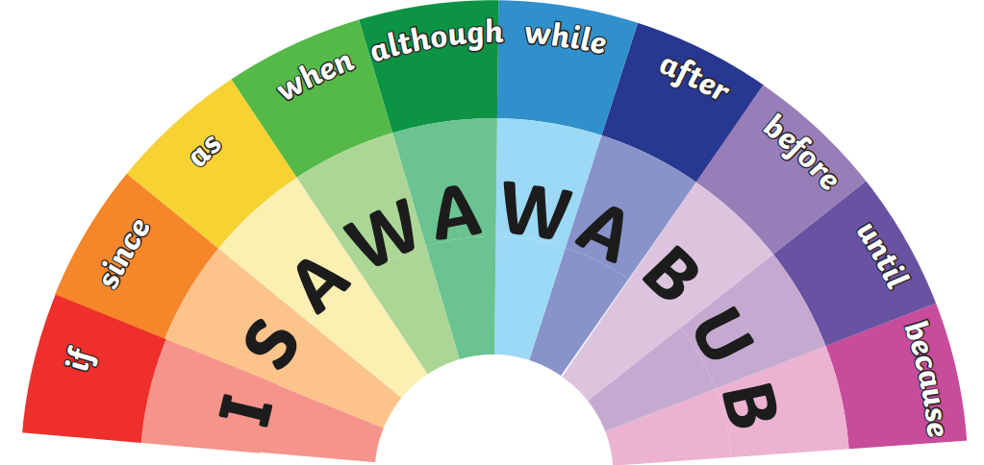
Spelling, Punctuation and Grammar Paper 1
The children will have been working hard with their class teacher on developing and securing the knowledge of the technical vocabulary needed in this test.
This test focuses on:
Grammatical terms/word classes
Functions of sentences
Combining words, phrases and clauses
Verb forms, tenses and consistency
Punctuation
Vocabulary
Standard English and formality

Slide 13
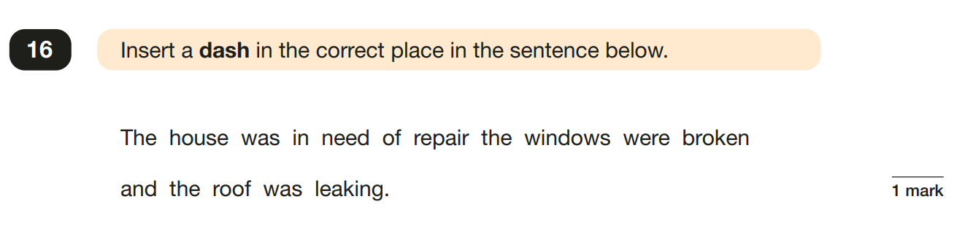
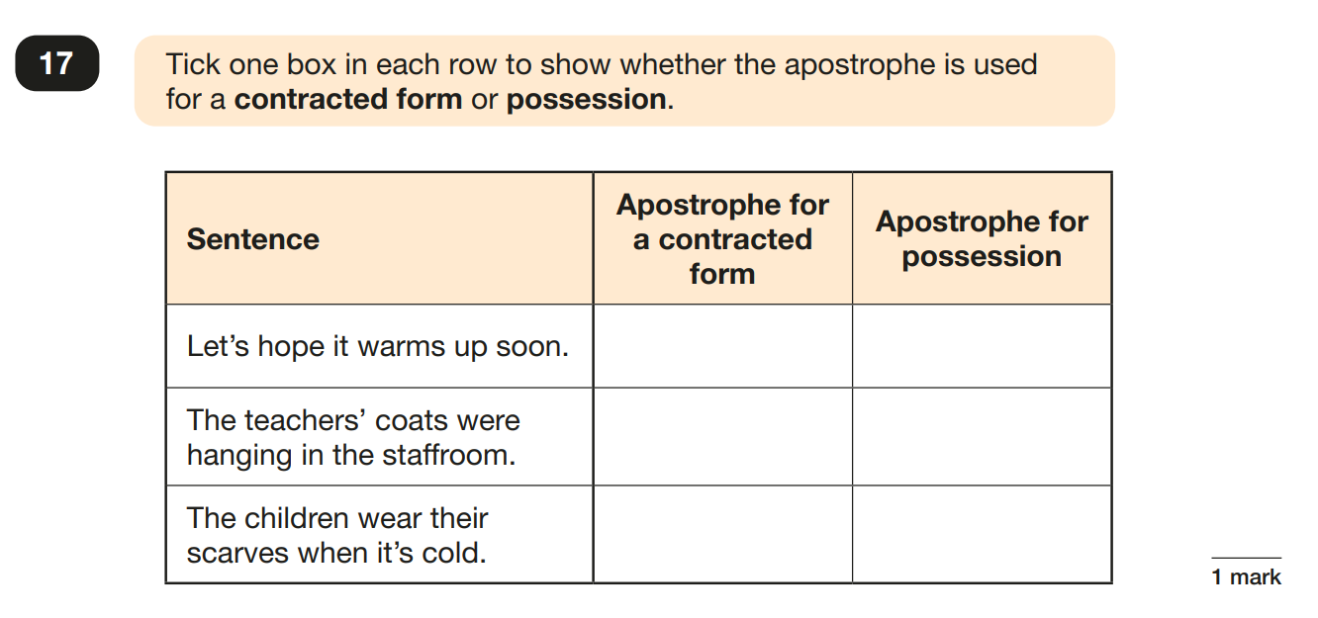
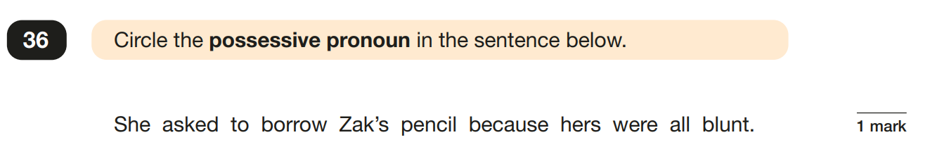
Spelling, Punctuation and Grammar Paper 1

Slide 14
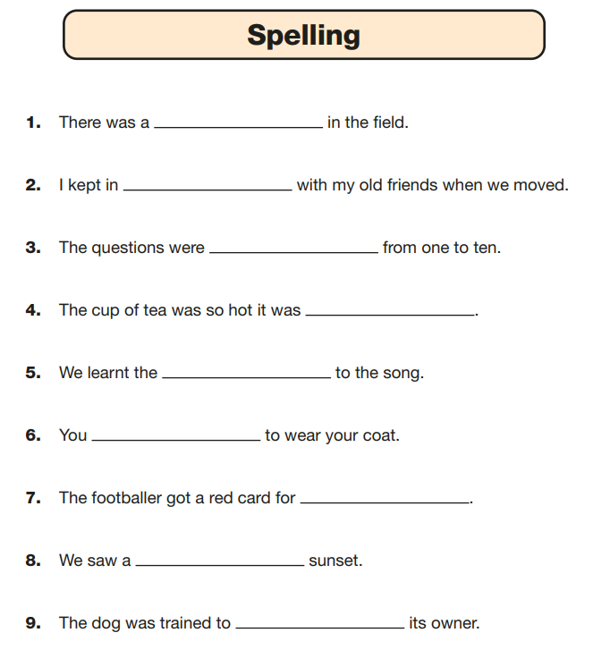
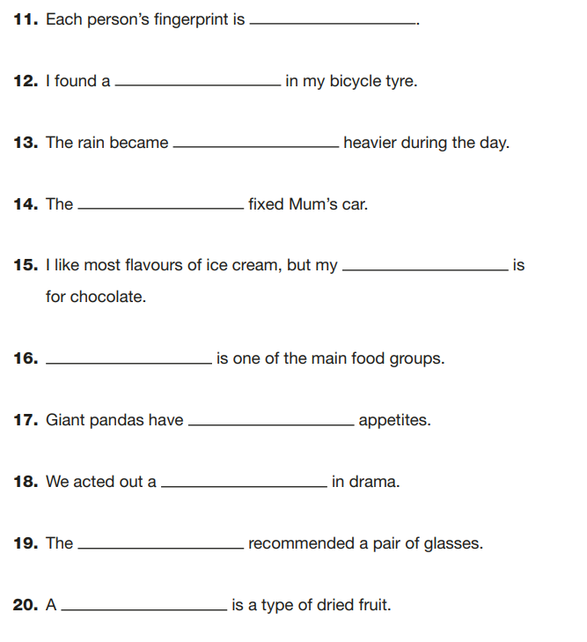
Spelling, Punctuation and Grammar Paper 2

Slide 15

English reading

Slide 16
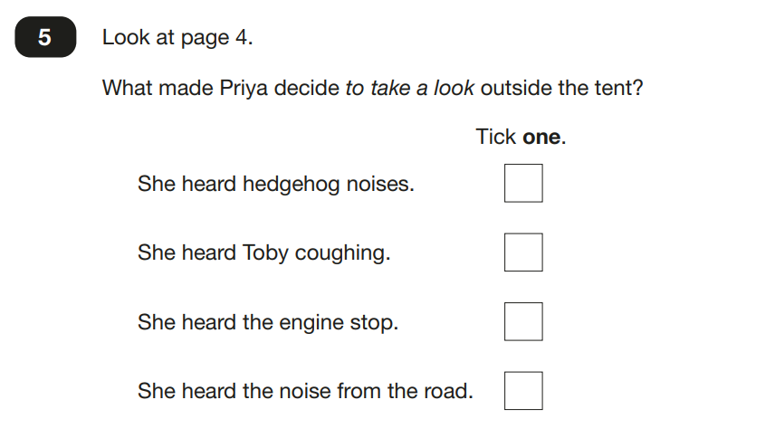
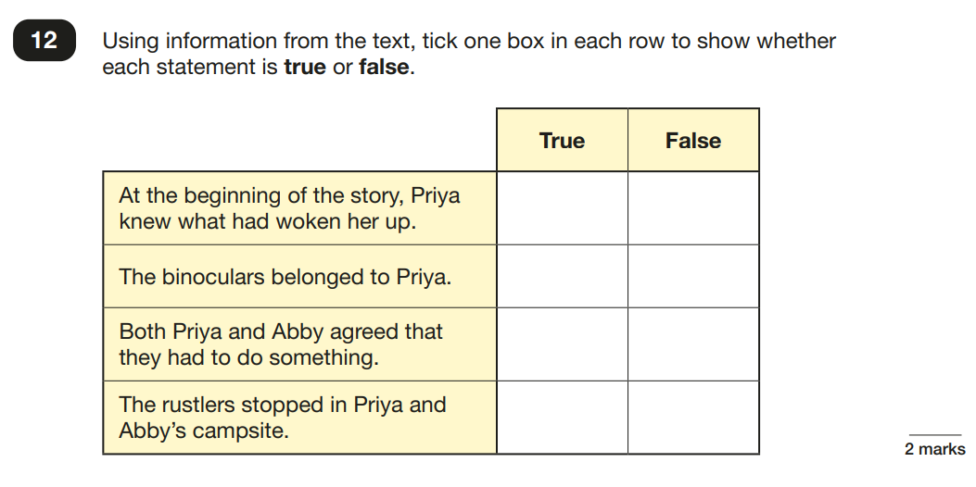
English reading

Slide 17
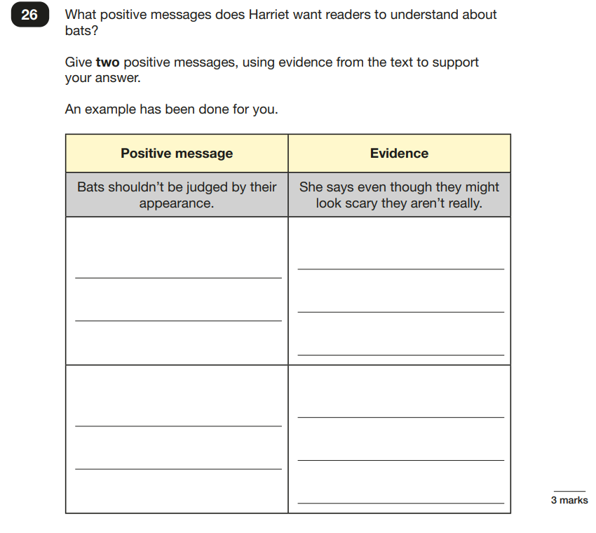
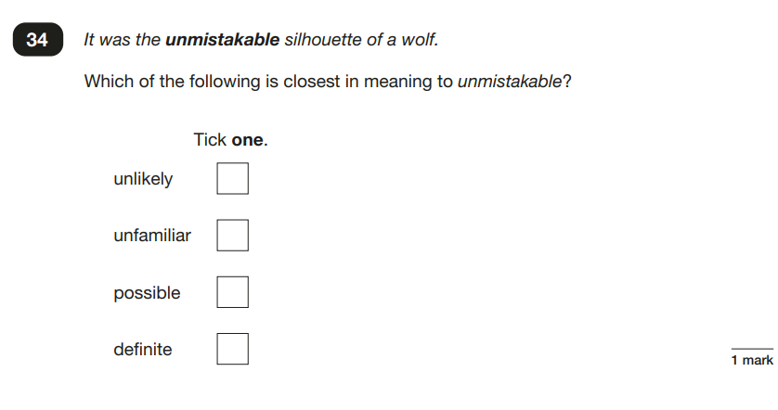
English reading

Slide 18
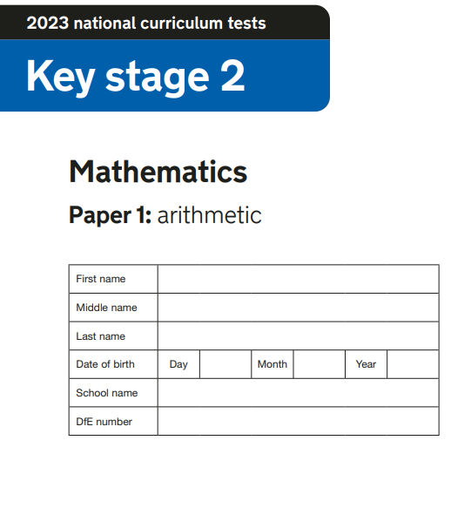
MATHEMATICS PAPERS
The tests will cover:
Number and place value
The four operations (addition, subtraction, multiplication and division)
Statistics
Measurement (length, perimeter, mass, volume, time, money)
Algebra
Ratio and proportion
Fractions, decimals and percentages

Slide 19
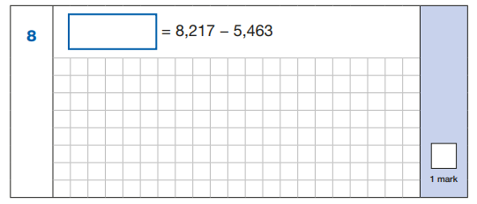
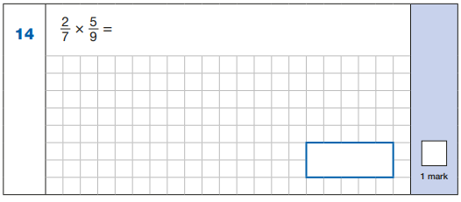
MATHEMATICS PAPER 1: ARITHMETIC

Slide 20
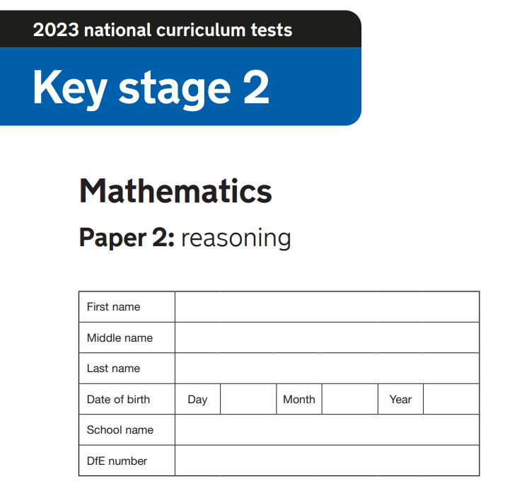
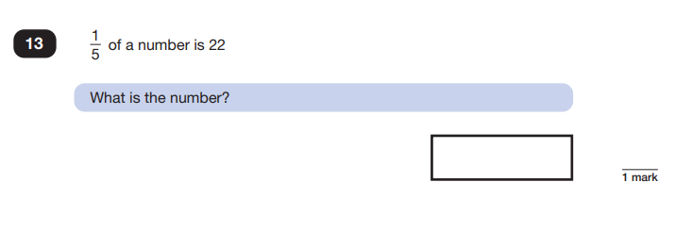
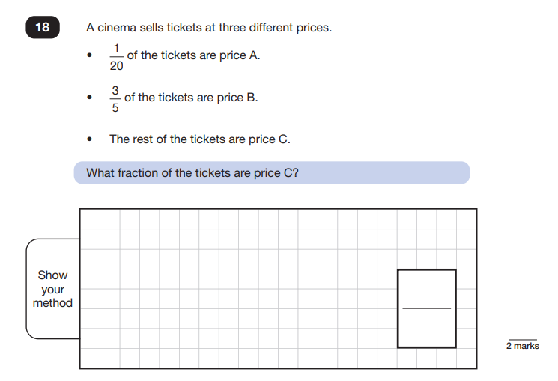
MATHEMATICS PAPER 2: REASONING

Slide 21
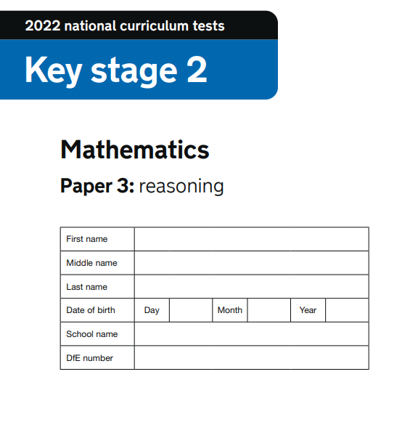
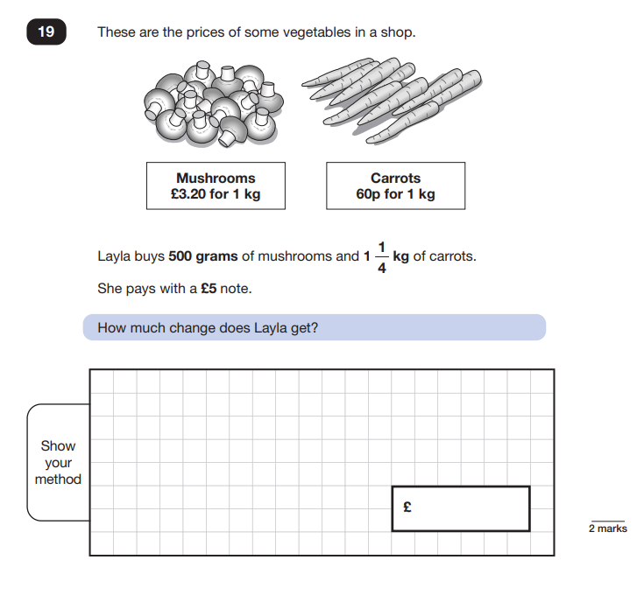
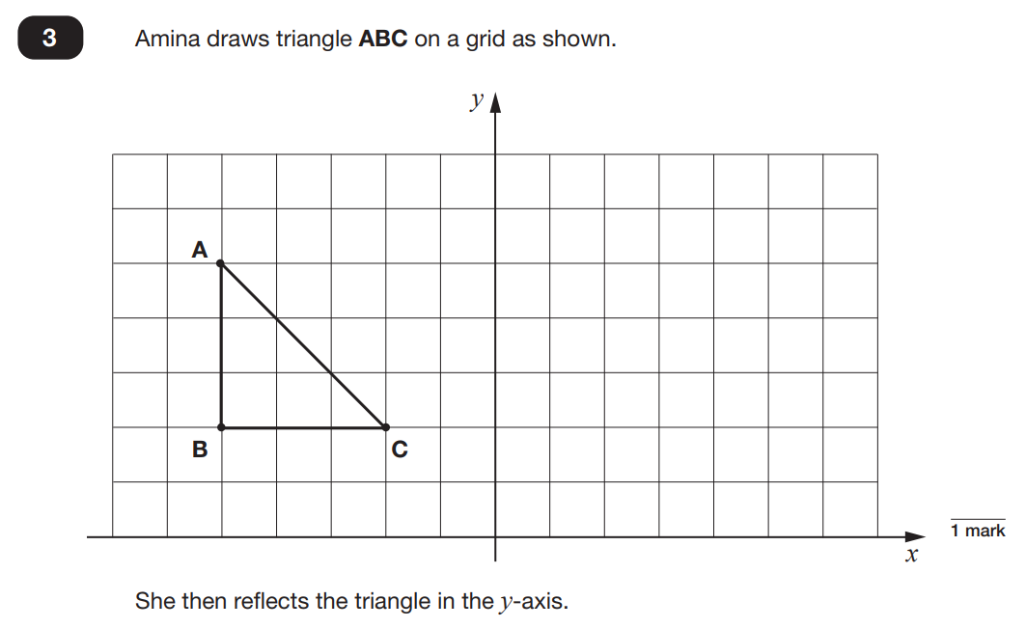
MATHEMATICS PAPER 3: REASONING

Slide 22
SPECIAL ARRANGEMENTS

Slide 23
SPECIAL ARRANGEMENTS
Children with additional needs (who have similar support as part of day-to-day learning in school) may be allotted specific arrangements including:
Additional time
Tests being opened early to be modified
An adult to scribe for them
An adult to read for them
The use of prompts or rest breaks
Arrangements for children who are ill or injured at the time of the tests
Pupils with an EHCP are automatically allowed up to 25% additional time (except for the spelling paper, which is not timed). Pupils who use the modified large print or braille versions of the tests are automatically allowed up to 100% additional time.

Slide 24
WRITING

Slide 25
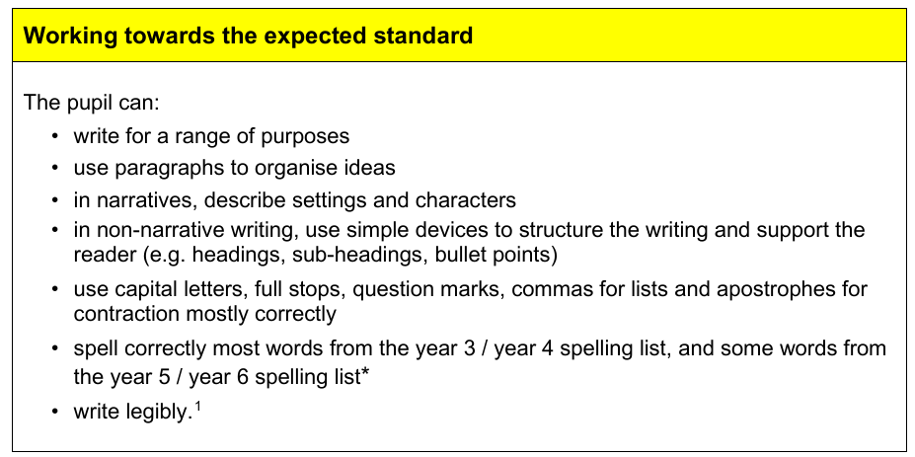

Slide 26
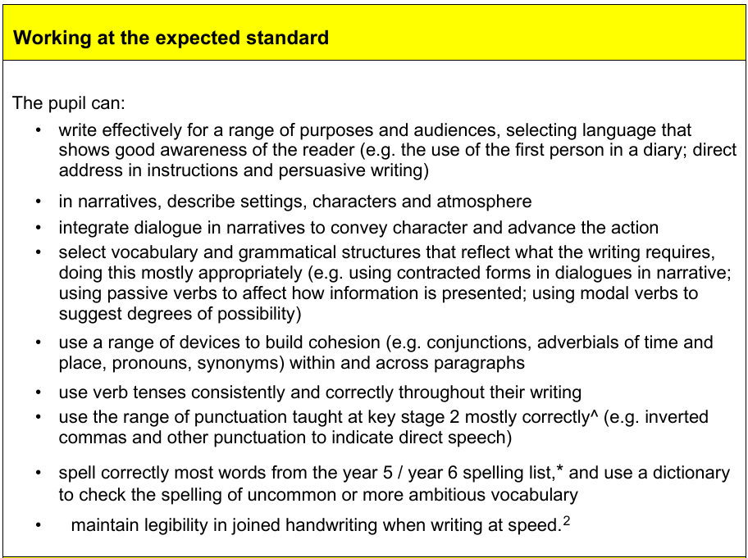

Slide 27
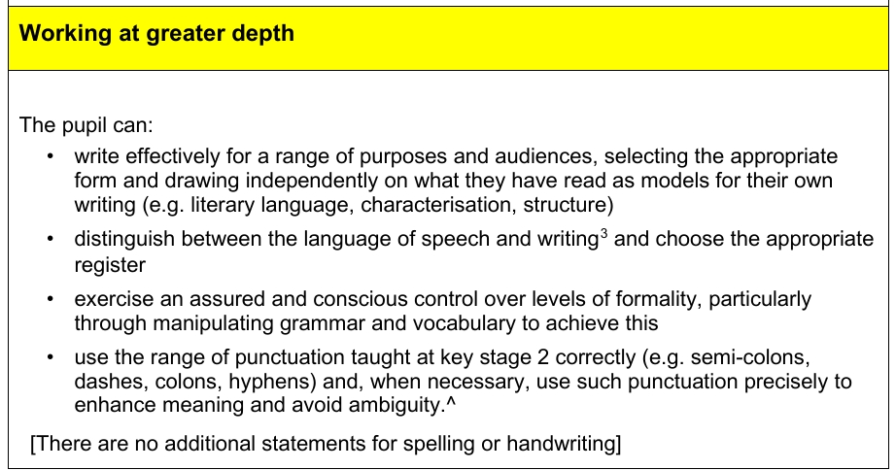

Slide 28
How can you help your child?

Slide 29
We ask that children do not complete past papers. We use these for mocks and need accurate scores and question analysis of how they are performing to inform our planning and teaching.
PAST PAPERS

Slide 30
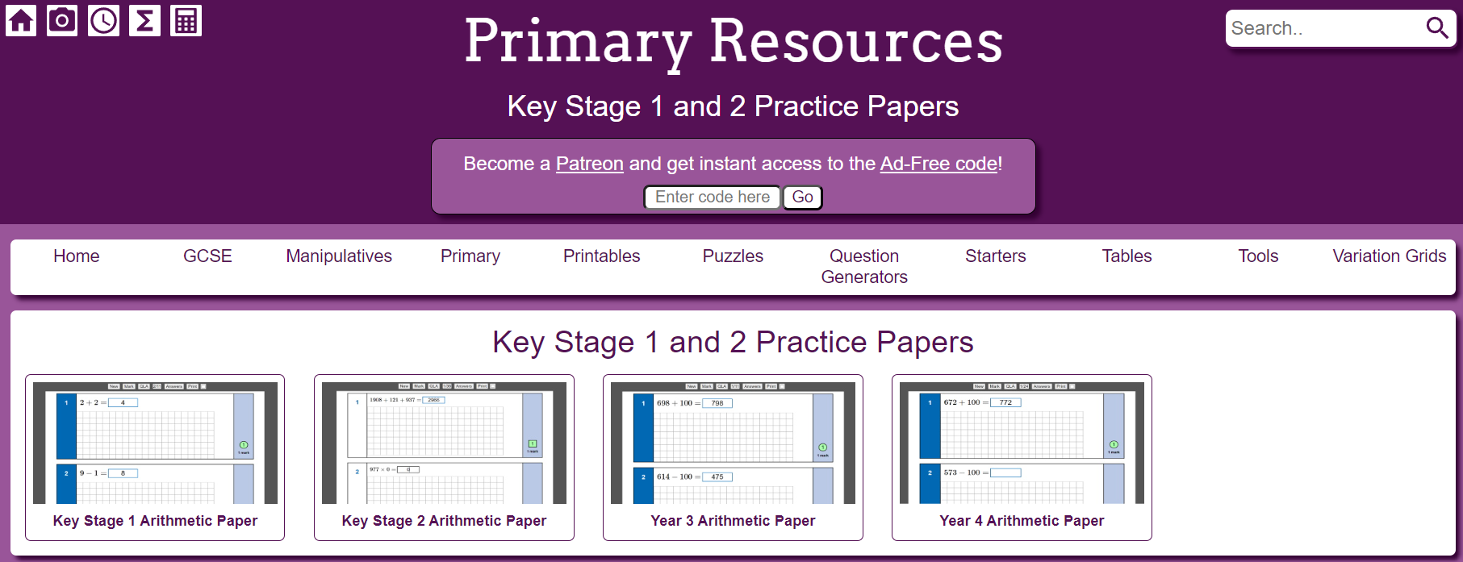

MATHS
Primary Resources - MathsBot.com

Slide 31
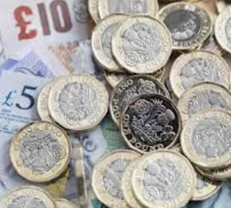
Maths
Play times tables games
Play mental maths games including counting in different amounts, forwards and backwards
Encourage opportunities for telling the time
Encourage opportunities for counting coins and money; finding amounts for calculating change when shopping
Read longer number e.g. house prices
Look for examples of 2D and 3D shapes around the home
Identify, weigh or measure quantities and amounts e.g. when cooking
Play games involving numbers or logic, such as dominoes, card games, monopoly

Slide 32

Reading
Encourage a love of reading
Enjoy stories together
Read a little at a time but often
Talk about the story before, during and afterwards- discuss the plot, characters, their feelings and actions, how it makes you feel, predict what will happen and form opinions.
Look up definitions of unknown words
All reading is valuable. Reading can include: fiction, non-fiction, poetry, newspapers, magazines, football programmes and TV guides
Visit a library

Slide 33
SPAG
Identify different skills in the children’s reading book e.g. can you see an example of a fronted adverbial?
Practise spellings at home
Online spelling and grammar games (Crickweb | KS2 Literacy)
BBC Bitesize videos

Slide 34
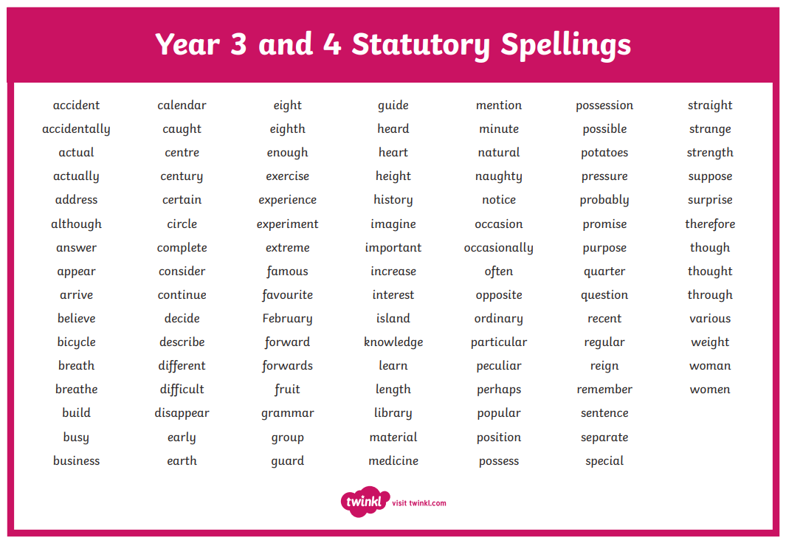
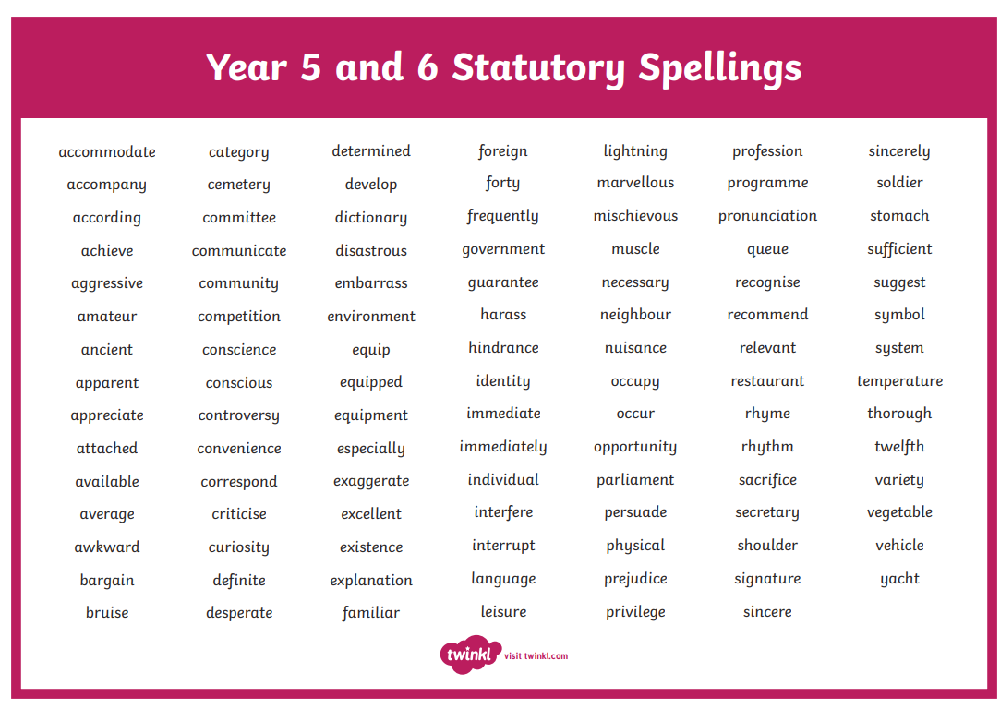
SPAG

Slide 35

Writing
Practise and learn weekly spellings- make it fun!
Encourage opportunities for writing such as letters to family or friends, shopping lists, notes or reminders, stories and poems
Write together- be a good role model for writing
Encourage use of a dictionary to check spelling and a thesaurus to find synonyms and expand vocabulary
Remember that good readers become good writers!

Slide 36

Supporting your child
Most importantly:
Ensure good attendance
Praise and encourage them

Slide 37
MOCK WEEK

Slide 38
MOCK WEEK
In February, we will have a mock week where the children will sit previous papers.
During this week, we will replicate what will happen on the actual week. For instance, going to the hall.
This is to help the children feel calm and prepared for when they sit the tests in May.

Slide 39
THE WEEK ITSELF

Slide 40

The week itself
The week beginning Monday 11th May 2026
We have found it is better if the children come in at their usual time, but we ask for support in ensuring they are here at 8:40.
A snack always helps!

Slide 41
THINGS TO REMEMBER

Slide 42

Things to remember
The wellbeing of your children is our priority.
It is important that the children feel calm and relaxed about their SATs.
We are here if you or your child has any concerns.
We are in this together; we believe in your children, and we will be doing everything to help them reach their full potential.

Slide 43
REVISION GUIDES

Slide 44



Revision Guides
We will place the order as a school to get a reduced price. There are books aimed at achieving the expected standard and books aimed at achieving the greater depth standard.
Deadline will be 6th October ready for the order to be placed. We will send communication later week with the recommendation for your child.

Slide 45

questions

Slide 46
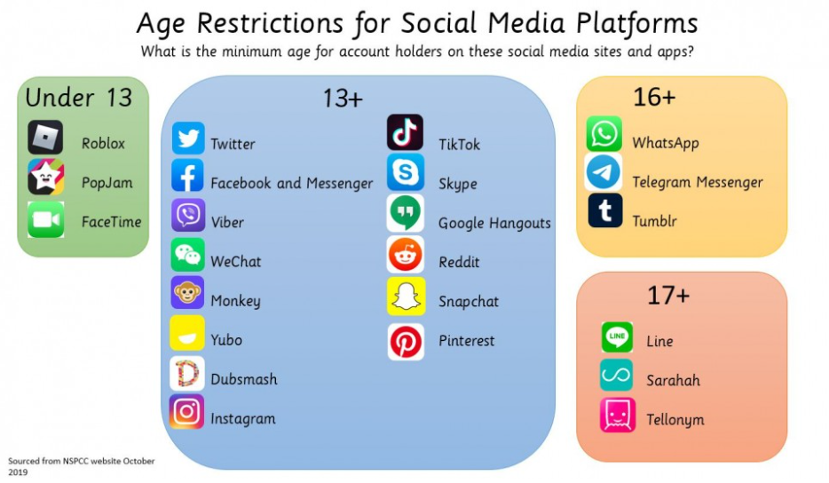

Recently changed from 16.

