Slide 1
Parent Meeting
Phonics Screening Check
Notes:
Approximately 10 minutes is needed for this session.
Notes are provided to help you lead the presentation.
Notes in italics are for your attention only.
Provide copies of ‘Reading at Home Booklet 2’ from Oxford Owl for each parent.

Slide 2
Reading changes everything
Teach a child to read and keep that child reading and we will change everything.
And I mean everything.
Jeanette Winterson
Notes:
Read quote.
By the end of Year 1, we want all of our children to be able to read accurately – to read both familiar and unfamiliar words - so that they can go on to become a fluent, enthusiastic reader.
The Phonics Screening Check in June in year 1 is a word reading test to check children can read sounds in words accurately.
Accurate word reading at 6 is a predictor of future success.

Slide 3
What is the Phonics Screening Check?
The phonics screening check is taken individually by all children in Year 1 in England, and is usually taken in June.
It is designed to give teachers and parents information on how your child is progressing in phonics.
It will help to identify whether your child needs additional support at this stage so that they do not fall behind in this vital early reading skill.
Notes:
Children complete the phonics screening check at the end of Year 1 so that parents can be confident their children are being taught to read successfully.
Children read 40 words. It takes between two and five minutes.
If they do not manage to read 32 of the words successfully, they are given extra support, and repeat the check at the end of Year 2.
It means that all children will be able to read accurately before they begin Year 3.

Slide 4
What is the phonic screening check?
There are two sections in this 40-word check and it assesses phonics skills and knowledge learned through Reception and Year 1. Your child will read up to four words per page for their teacher and they will probably do the check in one sitting of about 5–10 minutes.
You can download a copy of the 2018 Phonics screening check and 2019 Phonics screening check from the gov.uk website
https://www.gov.uk/government/publications/phonics-screening-check-2019-materials

Slide 5
What sort of test is it and is it compulsory?
It is a school-based check to make sure that your child receives any additional support promptly, should they need it.
It is not a stressful situation as the teacher will be well-equipped to listen and understand your child’s level of skills.
There will be a few practice words first to make sure your child understands the activity.

Slide 6
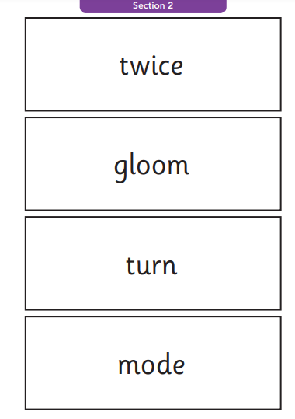
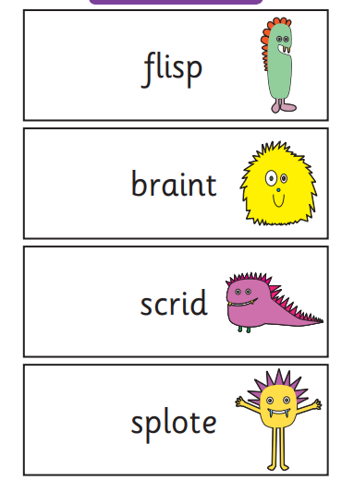
What does it check?
It checks that your child can:
Sound out and blend graphemes in order to read simple words.
Read phonically decodable one-syllable and two-syllable words, e.g. cat, sand, windmill.
Read a selection of nonsense words which are referred to as pseudo words.

Slide 7
What are the nonsense or pseudo words and why are they included?
These are words that are phonically decodable but are not actual words with an associated meaning e.g. brip, snorb.
Pseudo words are included in the check specifically to assess whether your child can decode a word using phonics skills and not their memory.
The pseudo words will be shown to your child with a picture of a monster and they will be asked to tell their teacher what sort of monster it is by reading the word. This not only makes the check a bit more fun, but provides the children with a context for the nonsense word which is independent from any existing vocabulary they may have.
Crucially, it does not provide any clues, so your child just has to be able to decode it. Children generally find nonsense words amusing so they will probably enjoy reading these words.

Slide 8
How will my child be scored? Is there a pass mark?
The check is not about passing or failing but checking appropriate progress is being made.
If children do not reach the required standard, then we will offer additional, tailored support to ensure that your child can catch up.
Children progress at different speeds so not reaching the threshold score does not necessarily mean there is a serious problem. Your child will re-sit the check the following summer term.
For the last few years, the threshold mark (or pass standard) set by the government has been 32 correct answers out of 40.

Slide 9
What happens to the result?
The school will report your child’s results to you by the end of the summer term as well as to the local authority, but the results won’t be published in a league table as with SATs.
If you have any concerns, do talk to your teacher about this in a parents’ meeting or after school

Slide 10
Do all schools and children have to participate?
All schools and academies in England must take part in the phonics screening check unless they are an independent school.
There is a process in place for reviewing children with special educational needs, so if your child’s teacher thinks there are very special reasons related to your child and their needs that make them think the phonics screening check may not be appropriate, they will decide on appropriate action and discuss this with you

Slide 11
What can I do to help my child?
Check with your child’s teacher if there are any particular areas that you should focus on at home so that you are working together to support your child.
When reading the online book always go through the sounds at the beginning of the book and see which sounds they are unsure of.

Slide 12
Speed Sounds Set 3
These are the sounds that your child has been taught. The words will use combinations of these sounds so it is essential your child knows them all. Practise at home when doing reading. The sounds can be found in the front of the books.
Notes:
Children learn all of the sounds on this chart.
Once they know all of these sounds, they will be able to read any unfamiliar word.

Slide 13

‘Special Friends’, ‘Fred Talk’
When sounding out a word your child should use: special friends – Fred talk – read the word.
Notes:
We teach children to words using the routine ‘Special Friends’, ‘Fred Talk’, read the word’.
Children spot the ‘Special Friends’ (two letters that make one sound), Fred talk the word, and then read the whole word.
For example, ‘sh’, sh-i-p, ship.

Slide 14
What should I do if my child is struggling to decode a word?
Look first for the ‘special friends’ These are the 2 or 3 letter sounds such as ch, ph, air, igh
Blend the sounds by pointing to each letter, i.e. /b/ in bat, or letter group, i.e. /igh/ in sigh, as you say the sound, then run your finger under the whole word as you say it.
Talk about the meaning if your child does not understand the word they have read.
Work at your child’s pace.
Always be positive and give lots of praise and encouragement.

Slide 15



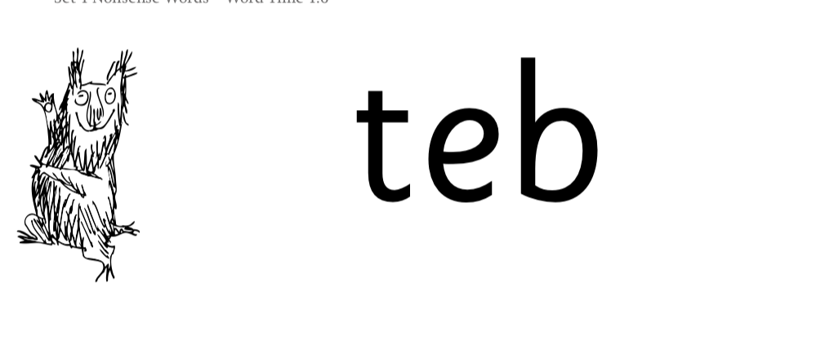
Nonsense words
There is a picture of an alien next to each word to remind the children that it isn’t a real word.
They read these words using the same routine as real words – ‘Special Friends, Fred Talk, read the word.’
Children who can read nonsense words will, very soon, be able to read any new word – for example – gargantuan, flailing, raucous, anticipation;
Reading new words increases children’s vocabulary rapidly.
Notes:
Half of the words in the check are real words.
Half are nonsense words. For example, ‘sheb’, ‘glight’, ‘ched’, ‘teb’.
There is a picture of an alien next to each word to remind the children that it isn’t a real word.
Nonsense words are used to assess children’s reading.
They check that children will be able to read sounds the sounds they know in unfamiliar words.
They read these words using the same routine as real words – ‘Special Friends, Fred Talk.’
Children who can read nonsense words will, very soon, be able to read any new word – for example – gargantuan, flailing, raucous, anticipation;
Reading new words increases children’s vocabulary rapidly.

Slide 16
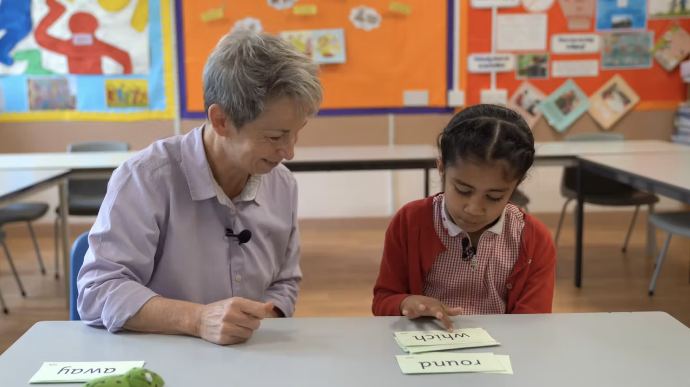
Teach every child to read
At Coundon, we aim to make sure that every child learns to read accurately by the end of Year 1 so they are set up for success in school and in life.
As soon as we spot a child who needs extra practice learning to read sounds and words, we try to support them one-to-one for a few minutes every day.
Notes:
In our school, we aim to make sure that every child learns to read accurately by the end of Year 1 so they are set up for success in school and in life.
As soon as we spot a child who needs extra practice learning to read sounds and words, we teach them one-to-one for a few minutes every day.

Slide 17
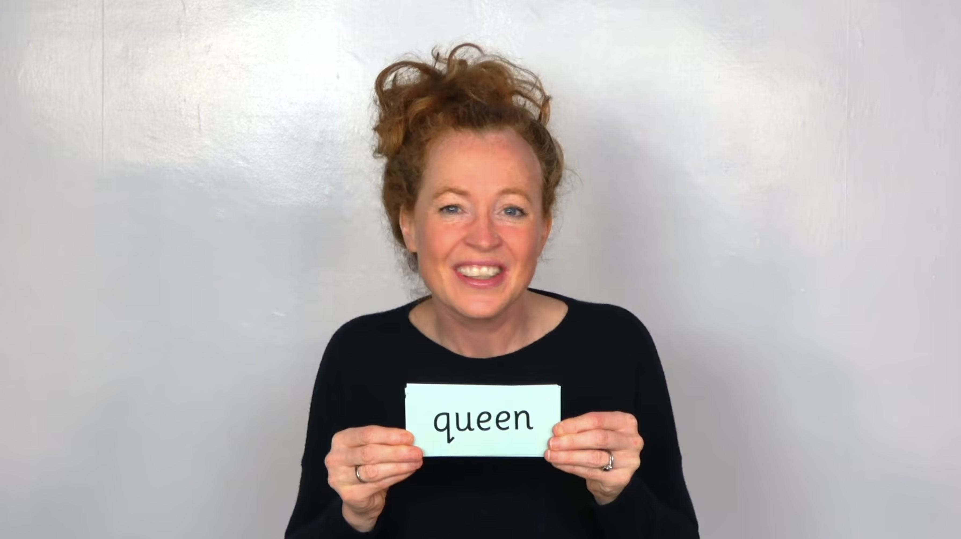
Virtual Classroom films
Each week, we will send home film links to lessons that match the sounds and words your child has learned in school.
You will find these in your child’s reading diaries or links on the year groups blog on the school website.
Your child uses the Virtual Classroom in school.
The children are familiar with the VC teachers – and interact with them as they would their own teacher.
Watch these films with your child to help them to practise reading the sounds and words until they can read them speedily.
The more they practise using these films, the quicker they’ll learn to read.
Simply click the link and watch on a tablet or other device.
Let’s have a look at one of these films on the Virtual Classroom.
https://schools.ruthmiskin.com/training/view/pZ7WG7EQ/VsyIsmBC
Notes:
Each week, we will send home film links to lessons that match the sounds and words your child has been learning in school.
Plus 3-minute 'Special Friends, Fred Talk' Virtual Classroom films. Yop will find these in your child’s reading diaries or links on the year groups blog on the choll website.
Your child uses the Virtual Classroom in school.
Children are familiar with the VC teachers – and interact with them as they would their own teacher.
Watch these films with your child to help them to practise reading the sounds and words until they can read them speedily.
The more they practise using these films, the quicker they’ll learn to read.
Simply click the link and watch on a tablet or other device.
Let’s have a look at one of these films on the Virtual Classroom. Play a Set 2 or 3 Special Friends, Fred Talk lesson film from the virtual classroom.

Slide 18
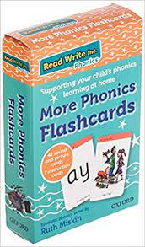
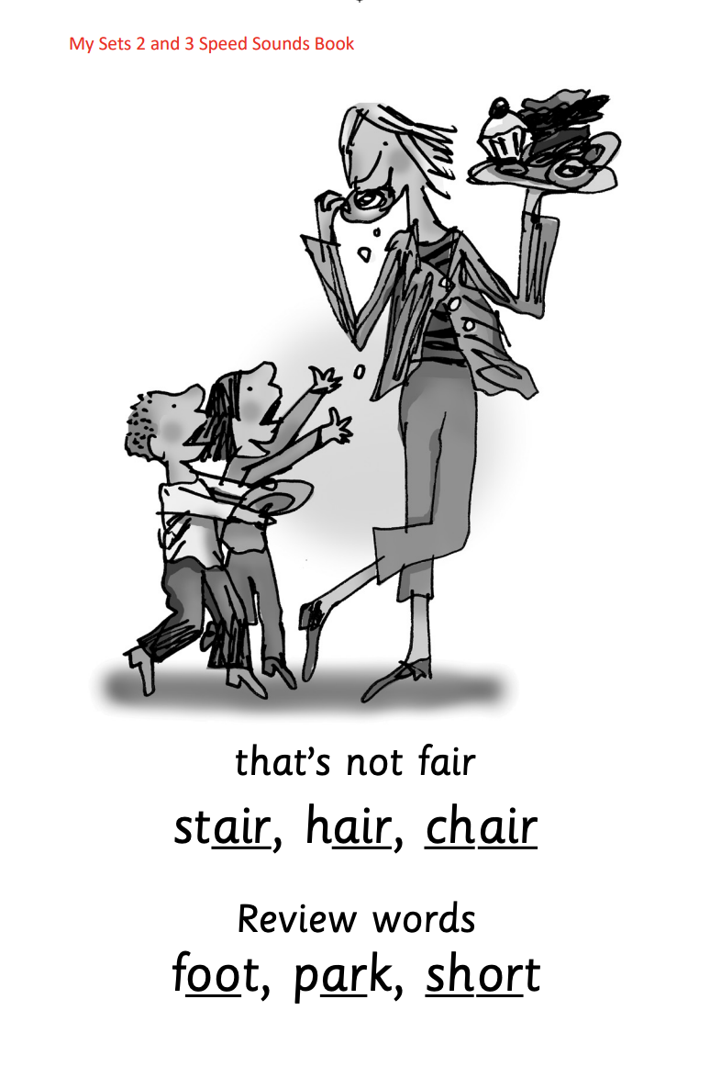





Practice at home
https://amzn.eu/d/5V7tOtv
Sound cards can be purchased from Amazon if you would like a set at home. Go through the set 2 and 3 sounds regularly and see if your child can read words made up of the sounds.
We can provide a paper copy of the sounds if needed – please ask a member of the Year 1 team and we can copy some for you.
Notes:
Discuss the one that is applicable to your school:
Your child will also bring home a My Set 2 and 3 Speed Sounds books to practise reading and writing the Set 2 and 3 sounds and words.
There are instructions for you inside cover of the book.
Each week, your child will bring home the Speed Sounds cards they have been taught to practise reading sounds speedily.
You can purchase Set 2/3 flashcards or My Reading and Writing Kit ages 5-7 becoming a reader to support your child with Set 2 sounds at home if you wish.

Slide 19
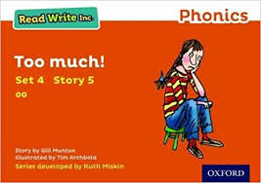

What can I do?
Help your child to use ‘Special Friends’, ‘Fred Talk’ to read words.
Practise reading sounds speedily.
Watch the Virtual Classroom films together.
Listen to your child read their Storybook every day and their on-line book and quiz..
Notes:
Help your child to use ‘Special Friends’, ‘Fred Talk’ to read words.
Practise reading sounds speedily.
Watch the Virtual Classroom films together.
Listen to your child read their Storybook every day.

Slide 20
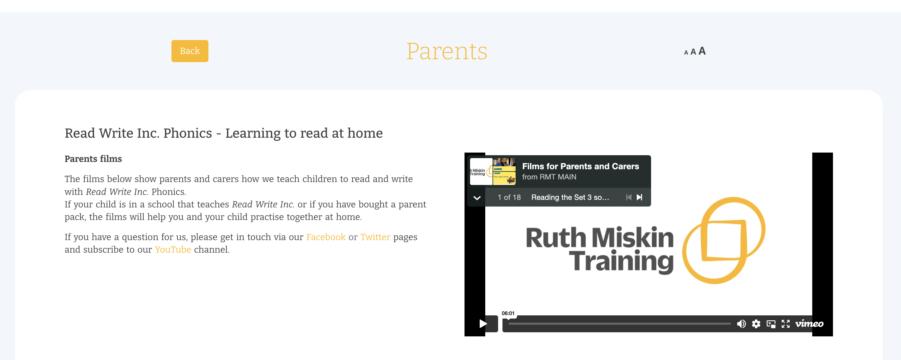
Free Video Tutorials (ruthmiskin.com)
http://www.oxfordowl.co.uk/read-write-inc-home
Notes:
Watch these video tutorials on the Ruth Miskin website to find out more about the PSC:
Understanding Phonics
The Phonics Screening Check

Slide 21
Online resources available
Ruth Miskin Parents’ Page:
https://www.ruthmiskin.com/parents/
Ruth Miskin Facebook:
https://www.facebook.com/miskin.education
Free e-books for home reading:
http://www.oxfordowl.co.uk/Reading/

Slide 22
Reading changes everything
Teach a child to read and keep that child reading and we will change everything.
And I mean everything.
Jeanette Winterson
Notes:
Remember that all parents have the power to change outcomes for their children.

Slide 23

Any questions?

